Slide 1
Assessment Lessons for The ESSA ERA

Slide 2
Our goals for today:
Investigate how ESSA frames Assessments
Discuss how to manage change in your district/school

Slide 3
Our goals for today:
Investigate how ESSA frames Assessments

Slide 4
Quick History Lesson
1983: A Nation at Risk document is released
1985: State Goals of Learning released in Illinois.
1994: Reauthorization of ESEA “Improving America’s Schools Act” brought state standards and state testing for all students.
2002: Reauthorization of ESEA “No Child Left Behind Act” brought broader state accountability for standards-based education to the forefront
2010: Illinois adopts Common Core State Standards
2011: PERA and SB 7 in Illinois
2015: PARCC and Smarter Balance Administered
2015: Reauthorization of ESEA: “Every Student Succeed Act” adopted.
2016: Illinois’ PERA implemented-student growth

Slide 5
Everyone Has a Role
Federal
ESEA law
Funding for ESEA (Title I, II, III, and V, VII)
State
Annual state-wide testing
Accountability: report results
Local
Alignment of assessments, instruction and curriculum
Teacher professional development
School Improvement of low-performing schools
High-quality classroom assessments of state standards
Implementation of student growth and professional practice in teacher evaluation model
Teacher evaluation model

Slide 6
@ Your Table, discuss
What is the purpose of assessments at the FEDERAL level?
What is the purpose of assessments at the DISTRICT level?
What is the purpose of assessments at the SCHOOL level?
What is the purpose of assessments at the CLASSROOM level?

Slide 7
What is ESSA?
Short version:
A makeover of NCLB
Federal Law
Longer version:
This federal law is the governing legislation for states, specifically Title programs in public schools.

Slide 8
http://www.ed.gov/essa?src=rnhttp://www.ed.gov/essa?src=rn

Slide 9
To work together with families and the community to inspire each child and to provide an outstanding educational foundation. (Rockton)
“WE ARE KNOXVILLE…educating all students to be
productive, involved members of our society” (Knoxville)
Provide learning opportunities and experiences to our students for a lifetime of growth and development. (Prairie Hill)
Our mission as an innovative, rural, educational community with a personal awareness of each student is to provide challenging educational experiences, enabling students to become responsible citizens through the cooperative efforts of the students, families, schools, and the community. (CUSD 3, Cuba)
"To encourage and empower all students to reach their highest potential.” (Kinnikinnick)

Slide 10
5 Things about ESSA and Assessments
Compiled by: The Alliance for Excellent Education is a Washington, DC–based national policy and advocacy organization dedicated to ensuring that all students, particularly those traditionally underserved, graduate from high school ready for success in college, work, and citizenship. For additional fact sheets and videos about ESSA, visit www.all4ed.org/essa/.

Slide 11
Annual Statewide Assessments
Every state can decide what state assessment they will use, but it must be….
Grades 3-8
ELA
Math
One time in Science
Grades 9-12
ELA
Math
One time in Science

Slide 12
New Assessment Flexibility
Assessments may be delivered, in part, in the form of projects, portfolios, and extended-performance tasks.
In high schools, districts may implement nationally recognized assessments that meet state and federal technical standards and are approved by “peer review” and the state.
States may, but are not required to, set a target limit on the aggregate amount of time spent on assessment administration.

Slide 13
Funding
ESSA maintains federal funding to support state assessments, authorizing up to $378 million annually. States may use these funds to develop and implement the annual assessments required under the law.
In addition, states and districts may use funds to develop balanced assessment systems (i.e., formative ,interim, and summative assessments) and competency-based assessments.
Furthermore, states may use federal funds to conduct assessment audits of state and district assessments to ensure they are necessary and of high quality.

Slide 14
Innovative Assessment Pilot
Allows up to seven states, and a consortia not to exceed four states, to implement an innovative assessment and accountability pilot. This pilot may include the use of competency- or performance-based assessments for accountability purposes, and removes the requirement for annual statewide assessments to be used for accountability purposes.

Slide 15
Opt-Out
At least 95 percent of students and 95 percent of each group of traditionally underserved students must be assessed. This provision aims to ensure that students will participate in annual statewide assessments.
Reminder: Illinois DOES NOT have an OPT-OUT policy.

Slide 16
Resource Roundrobgin @ your table
Go to Blendspace: http://tinyurl.com/ILASCDBlend
Each person summarize their tile to the group
Give each member of your table a tile (from 4-16) to view
Take 6 minutes to view
As a table, create 5 things you want others to know about ESSA.
Have the person with the least amount of experience write these down

Slide 17
http://www.ed.gov/essa?src=rnhttp://www.ed.gov/essa?src=rn

Slide 18
So,
We want our students to be learners for life; independent; self-confident.
How do we do this?

Slide 19
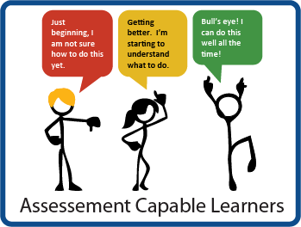
We create
J. Hattie, 2009

Slide 20
Assessment Capable Learners
Educators who help their students become assessment capable learners have students who:
know the learning target for a lesson,
can describe where they are in relation to the criteria,
and use that information to select learning strategies to improve their work.

Slide 22
This is our goal

Slide 23
Change, Change, Change

Slide 24
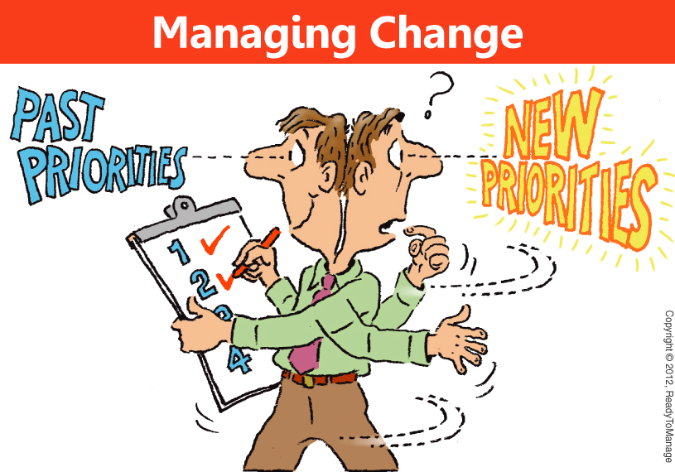
All this change….
but, would we want it to stay the same?

Slide 25
You’ll want to write this down
“Managing Complex Change”
Knoster, T., Villa, R., & Thousand, J. (2000)

Slide 27
Lets Look at the Data
www.tinyulr.com/ILASCD73116

Slide 28
What do you need to get for your staff?
Vision
Write it down
Speak it
Make sure leadership knows
Rinse and repeat
Vision = NO

Slide 29
What do you need to get for your staff?
Skills
Survey (Pre and Post)
Reiterate that everyone has skills
Reemphasis strengths
Use multiple ways
Groups
Readings
Videos
Observing

Slide 30
What do you need to get for your staff?
Incentives
Ask
Be consistent
Have variety for different people
Support

Slide 31
What do you need to get for your staff?
Resources
People
Places
Problems
Inside (and out) of district
Use of consultants

Slide 32
What do you need to get for your staff?
Action Plan
Start now for FY17
Plan each SIP/Institute/Late/Early start
Have measures to evaluate
WRITE IT DOWN
Share with all

Slide 33
What do you need to get for your staff?
Change = evolution
Change = reflection
Change = adjustments
Change = modifications

Slide 34
Look at your data and decide what you need to would do with this staff.
What do they need?
What could you give them?

Slide 36
What’s missing

Slide 37
Is Change Really That Hard?
The Backwards Brain Bicycle - Smarter Every Day 133 - YouTube

Slide 38
Tips to Help Teachers
Help them understand the difference between compliance and best practices.
Empower them to create (and re-create) classroom assessments to the learning standards.
Data must be shared with student. Everytime.

Slide 39
Tips to Help Administrators
Purpose is the most powerful motivator.
What is the purpose of statewide assessments?
Less is more. If something goes on your plate, something has to come off.
Stay within your strength zone. Find your allies.

Slide 40
What do you need to change?
Value your own style

