Slide 1
Leadership for Common Formative Assessment
“Accelerating your leadership impact”

Slide 2
Leadership for Common Formative Assessment Major Themes
Rely on leadership scenario planning
Acquire a deep understanding of our political and educational landscape
Nest the work in a compelling vision
Assess current organizational practice
Engage continuous improvement at the system level via lean leadership/six sigma
Identify MUDA
Establish student engagement as the big idea
Create a culture of improvement with persons outside the organization
Value education for economic development
Assess, then strengthen your PLC as a social network
Foster rapid cycle monitoring, feedback, and adjusting
Model 21st century work cultures
Rely on pareto charts and PLC protocols
Focus on talent development
Always actions

Slide 3
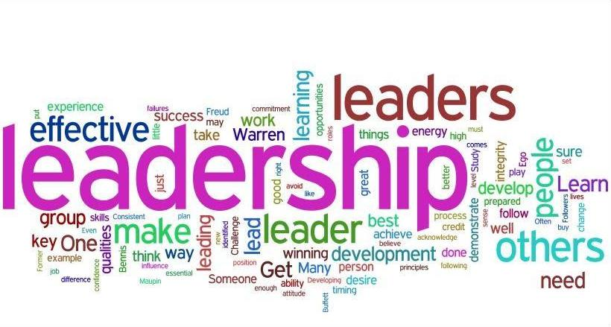
Rely on Leadership Scenario Planning

Slide 4
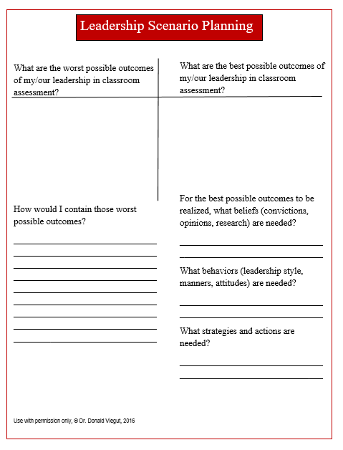
Rely on Leadership Scenario Planning

Slide 5

Acquire a Deep Understanding
of our Political and
Educational Landscape

Slide 6
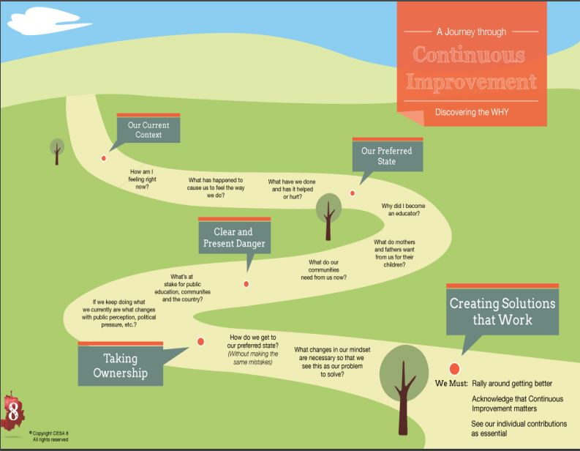
Acquire a Deep Understanding of our
Political and Educational Landscape

Slide 7

Nest the Work in a Compelling Vision

Slide 8
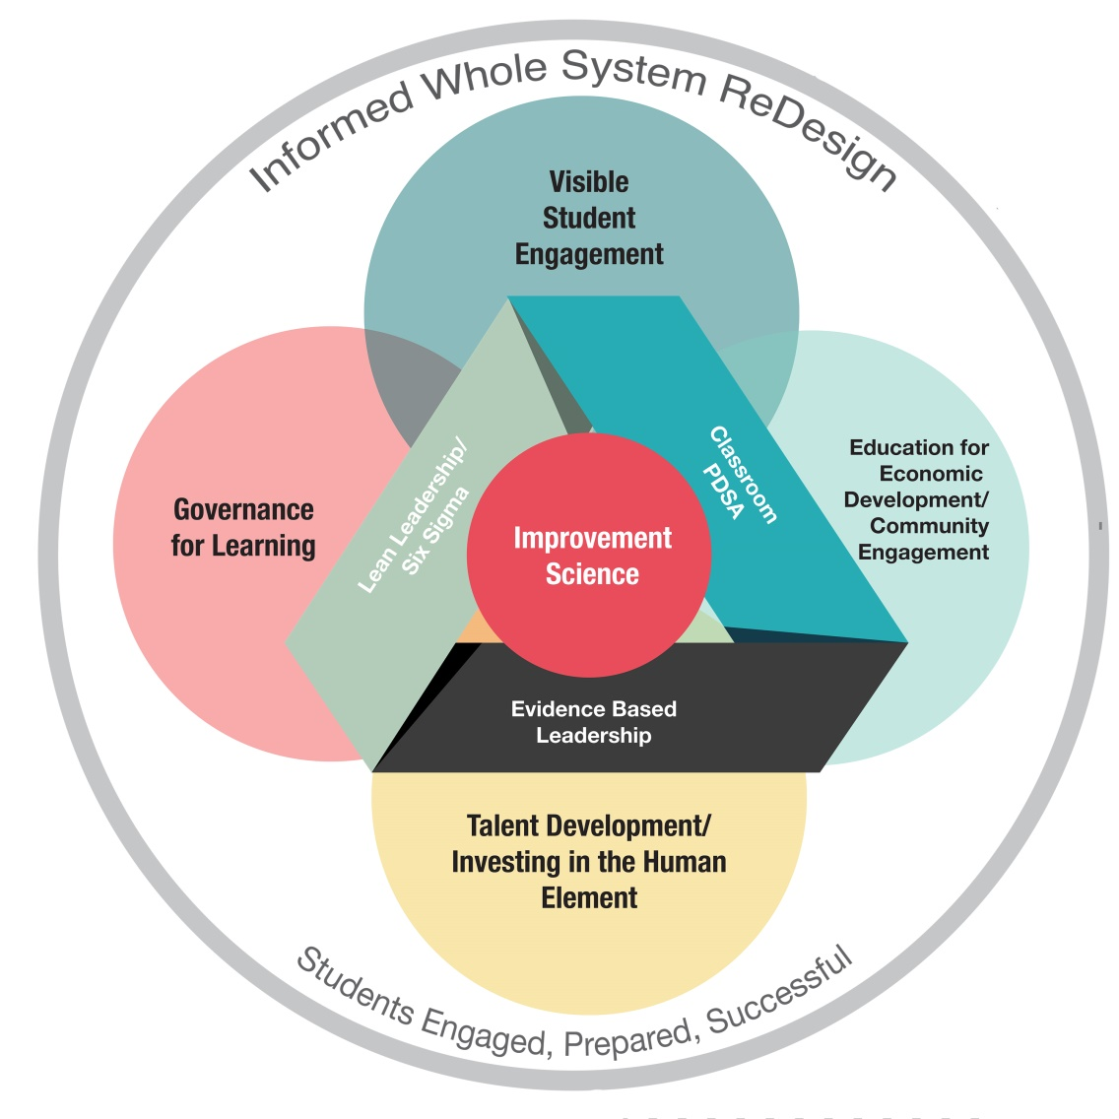
Nest the Work in a Compelling Vision

Slide 9
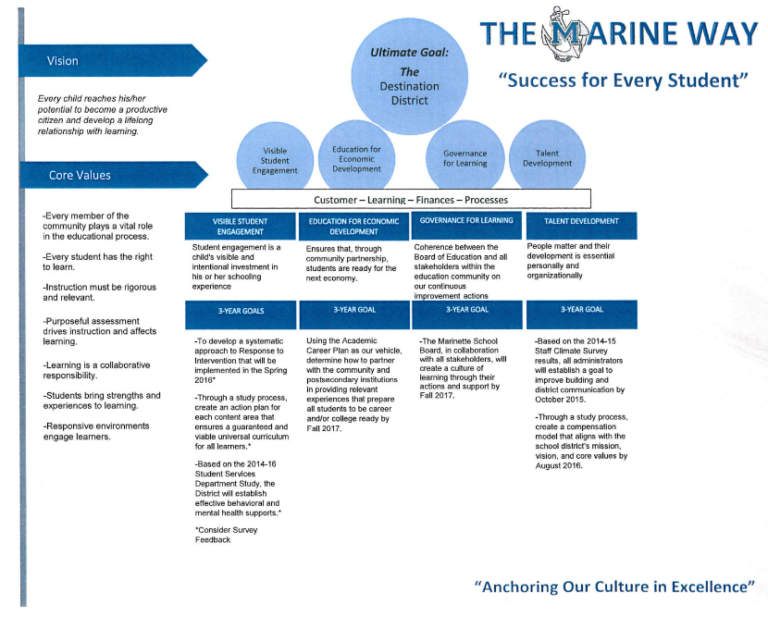
The Marine Way

Slide 10
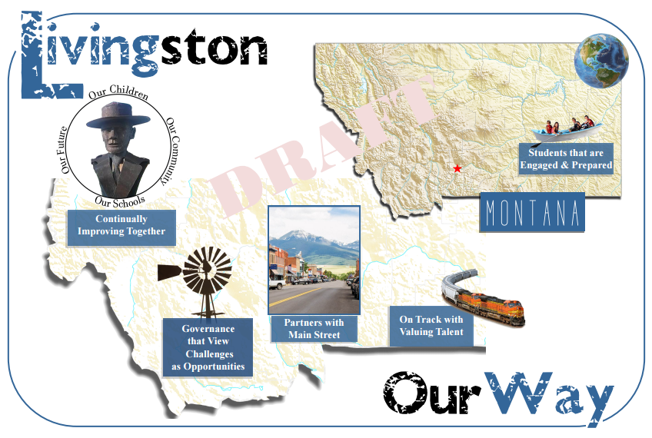
The Livingston Way

Slide 11
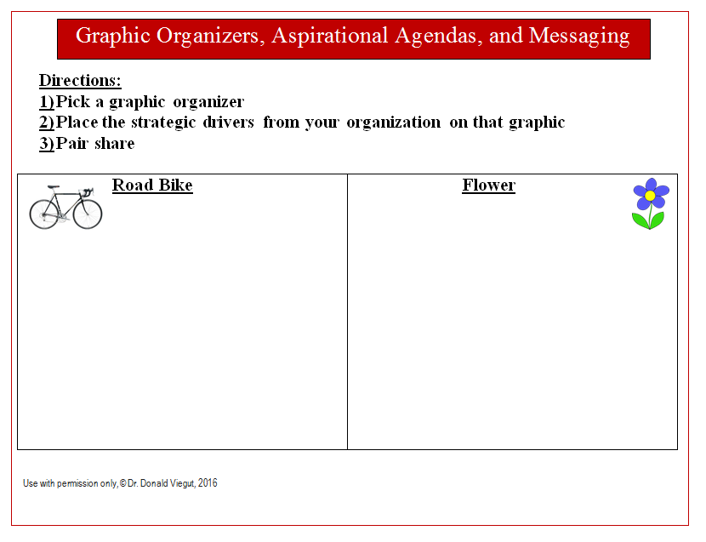
Nest the Work in a Compelling Vision

Slide 12

Assess Current Organizational Practice

Slide 13
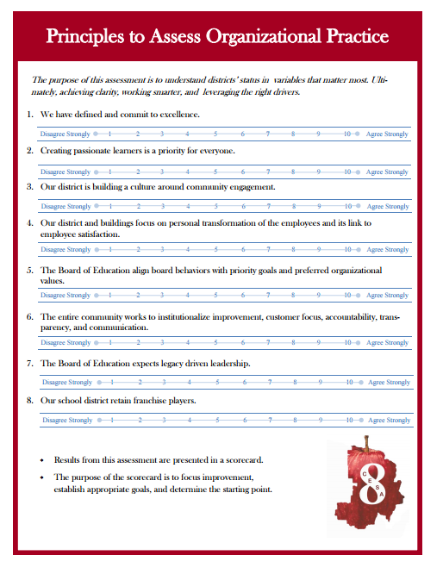
Assess Current Organizational Practice

Slide 14

Engage Continuous Improvement at the System Level via Lean Leadership/Six Sigma

Slide 15
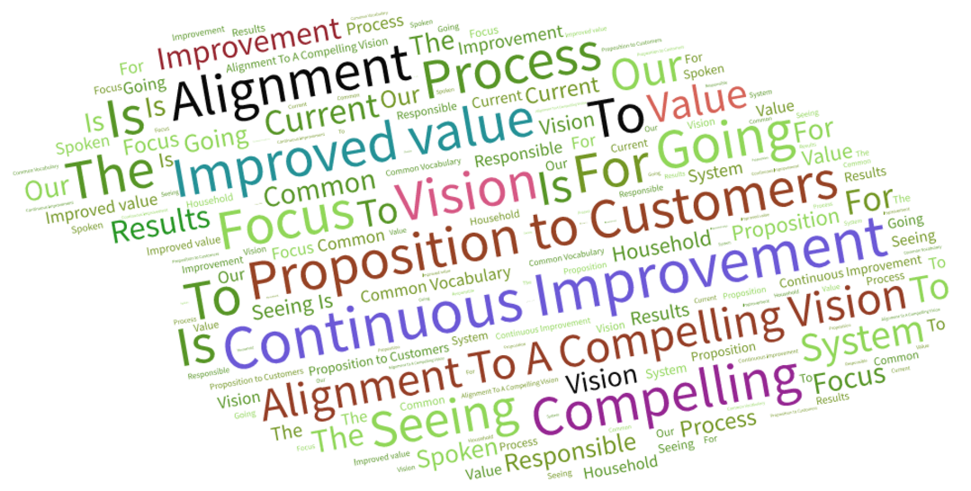
Engage Continuous Improvement at the System Level via Lean Leadership/Six Sigma

Slide 16
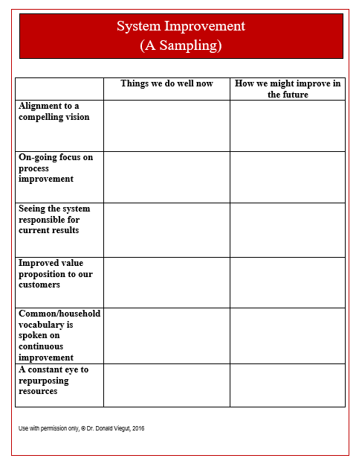
Engage Continuous Improvement at the System Level via Lean Leadership/Six Sigma

Slide 17
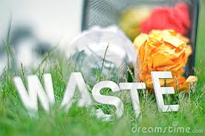
Identify MUDA

Slide 18
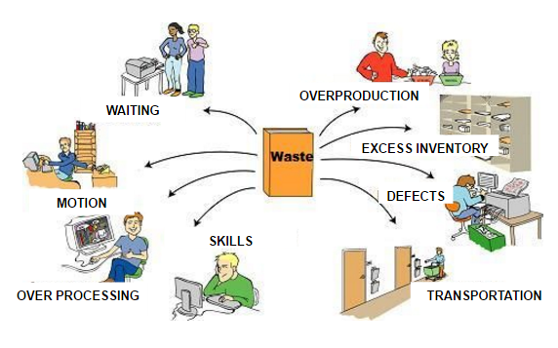
Identify MUDA

Slide 19
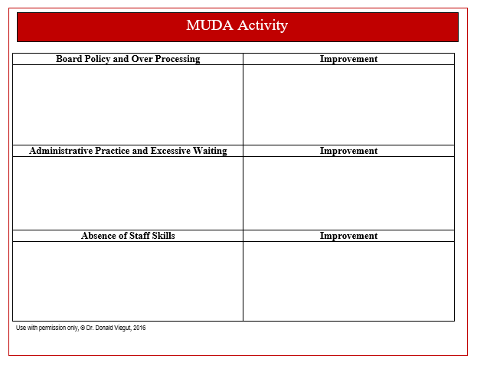
MUDA

Slide 20


Establish Student Engagement as the Big Idea

Slide 21

Creating Passionate
Learners
Dr. Donald Viegut
Notes:
An anachronism is the placement of an object or behavior that is clearly out of place in modern times.

Slide 22
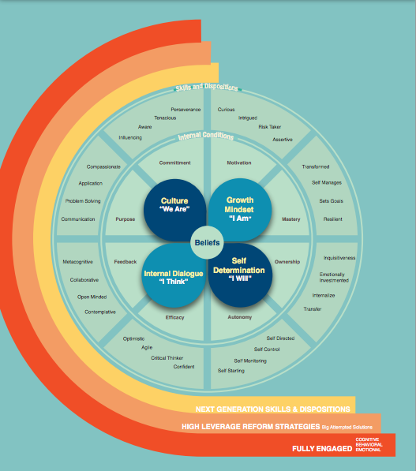
Notes:
Introduce framework for CPL – 4 beliefs, the internal conditions that are needed and the skills and dispositions
Taught, developed, acted on, and practiced
Within the beliefs, we have 4 key prompts that we use to support each child’s emotional, behavioral, and cognitive engagement….I am, I think, I will, and we are. These are used to recast the lens of school reform through student’s eyes

Slide 23
Internal Dialogue
“I Think”
Internal Dialogue: The discussion that occurs in your head regarding the thoughts and feeling of your experience

Slide 24
I
Commitment
Motivation
Growth Mindset “I Am”
Culture ”We Are”
Purpose
Mastery
Feedback
Internal Dialogue
“I Think”
Self
Determination
“I Will”
Ownership
Efficacy
Autonomy
Notes:
When students have positive internal dialogue, their efficacy increases. Our responses as adults, through our words and feedback, we can support or inhibit student’s internal dialogue which can affect their efficacy.

Slide 25
Self efficacy are the beliefs that lead to greater persistence in the face of difficulties, reduce fear of failure, improve problem-focused analytical thinking and raise aspirations
Bandura, 1995, p. 169

Slide 26
Notes:
Focus on upper right quadrant

Slide 27
How Does Language and Feedback Shape Mindsets?
The language we use tells others what we believe and what we value
Feedback tells us what is expected of us and what goals we should have
                Perks, 2015
Notes:
Part of the answer is that our language signals to others what we believe and what we value.
- What beliefs are being reinforced?
- What goals are being promoted?
- Are mistakes valued?

Slide 28
Words that Impact Feedback and Shape Behavior
Get back to work or you won’t go out for recess
This is not like you. What is the problem you have encountered? How will you solve it?
                Johnston, Choice Words, 2004
Notes:
Slave and owner vs. problem solvers

Slide 29
Leadership that Understands and Leverages the Power of Feedback
Feedback is one of the most powerful influences on learning and achievement, but this impact can be either positive or negative.
- Hattie & Timperley, 2007
Feedback can double the rate of learning.
- Wiliam, 2011

Slide 30
What do you notice about the following feedback?
Very good. You did a great job! I don’t think you put in any effort into that project. | I like the way you are sitting. I like how quietly you are speaking. I enjoyed hearing your story. | You are respectful. You are good at math. You really thought hard about that.

Slide 31
Judgment | Personal Observation | Inference
Very good. You did a great job! I don’t think you put in any effort into that project. | I like the way you are sitting. I like how quietly you are speaking. I enjoyed hearing your story. | You are respectful. You are good at math. You really thought hard about that.
Notes:
Criticism leaves the learner with a feeling of failure
Praise does not have a cognitive impact on students
Personal observation of the teacher. Not related to learning target. You statements – making a guess about what the student did.

Slide 32
What do you notice about the feedback in these examples?
Here you are talking about …and then you jump to… You completed two entries in your journal. | Here you are talking about …and then you jump to… Does that flow in your story? Why did you choose these strategies to solve that?
Notes:
Delineating between passive and active feedback

Slide 33
Feedback that emphasizes cognition
Data | Inquiry
Here you are talking about …and then you jump to… You completed two entries in your journal. | Here you are talking about …and then you jump to… Does that flow in your story? Why did you choose these strategies to solve that?
Notes:
Provides cognitive level of feedback that is internalized. Students learn to give themselves feedback. These levels improve student learning.

Slide 34
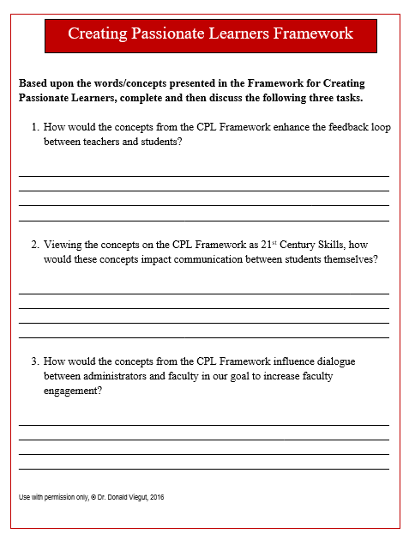
Establish Student Engagement as the Big Idea

Slide 35

Create a Culture of Improvement with Persons Outside the Organization

Slide 36
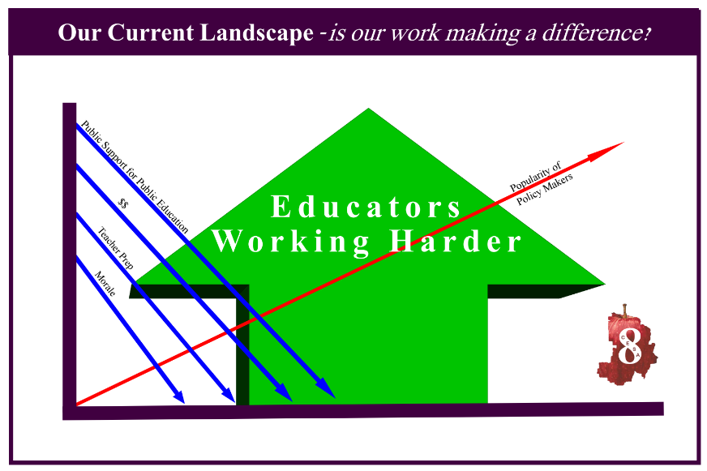
Create a Culture of Improvement with Persons Outside the Organization

Slide 37
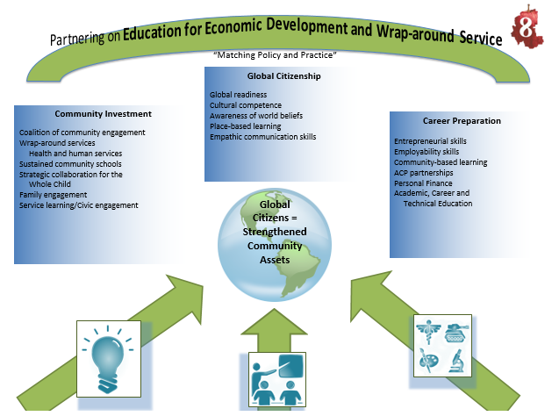
Create a Culture of Improvement with Persons Outside the Organization

Slide 38

Value Education for Economic Development

Slide 39
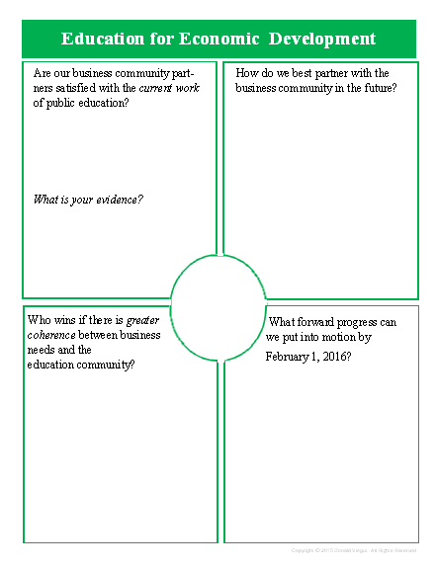
Value Education for Economic Development

Slide 40

Assess, then Strengthen your PLC as a Social Network

Slide 41
The Hidden Influence of Social Networks Video
https://www.youtube.com/watch?v=VQEf-JyBnZ0

Slide 42
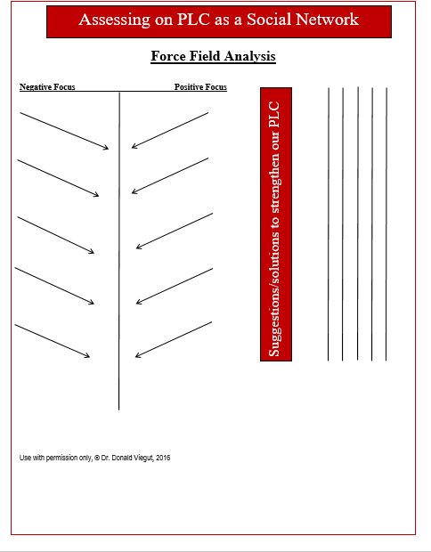
Assess, then Strengthen your PLC as a Social Network

Slide 43

Foster Rapid Cycle Monitoring, Feedback, and Adjusting

Slide 44
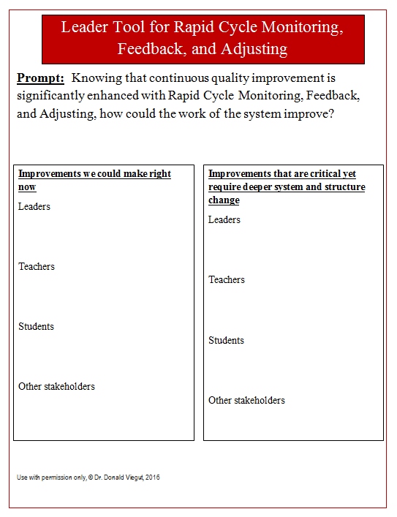
Foster Rapid Cycle Monitoring, Feedback, and Adjusting

Slide 45

Model 21st Century Work Cultures

Slide 46
HubSpot Video
https://www.youtube.com/watch?v=EXOtTvb5OFE

Slide 47
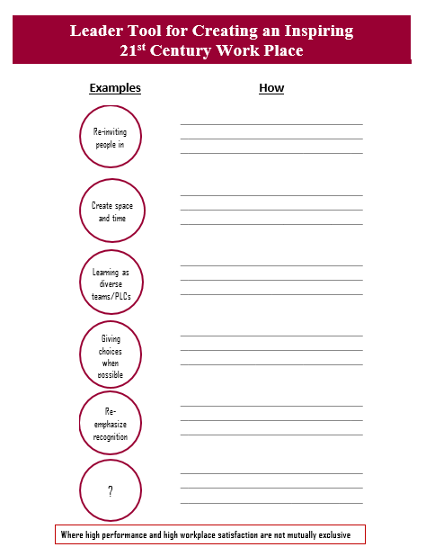
Model 21st Century Work Cultures

Slide 48
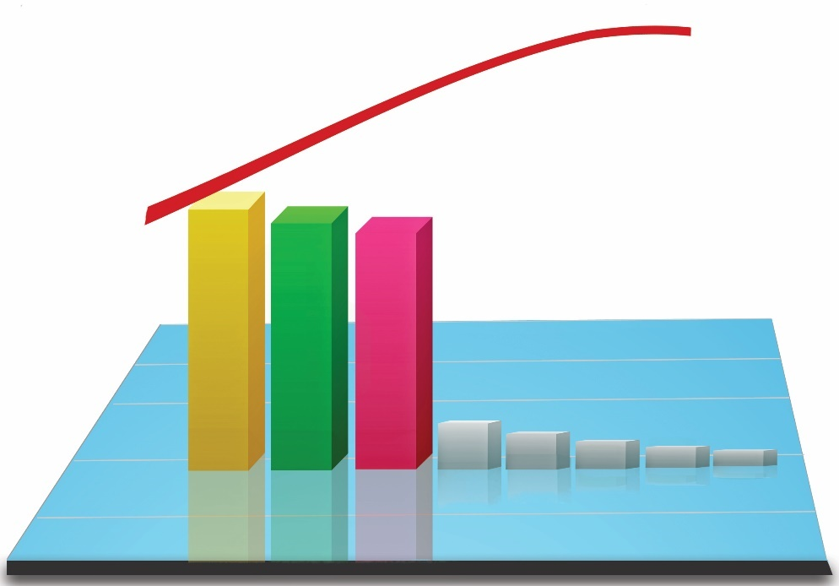
Rely on Pareto Charts and PLC Protocols

Slide 49
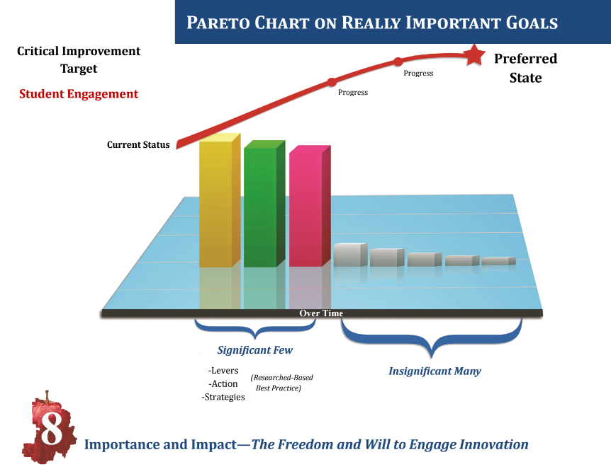
Rely on Pareto Charts and PLC Protocols

Slide 50
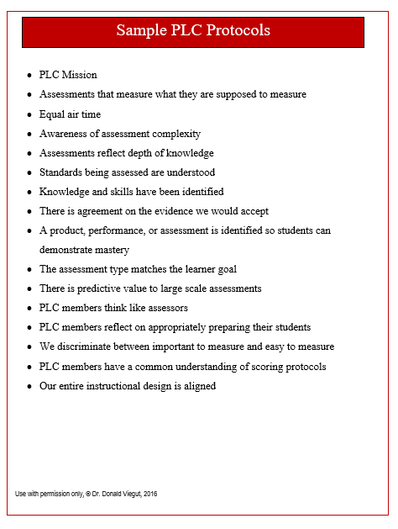
Sample PLC Protocols

Slide 51
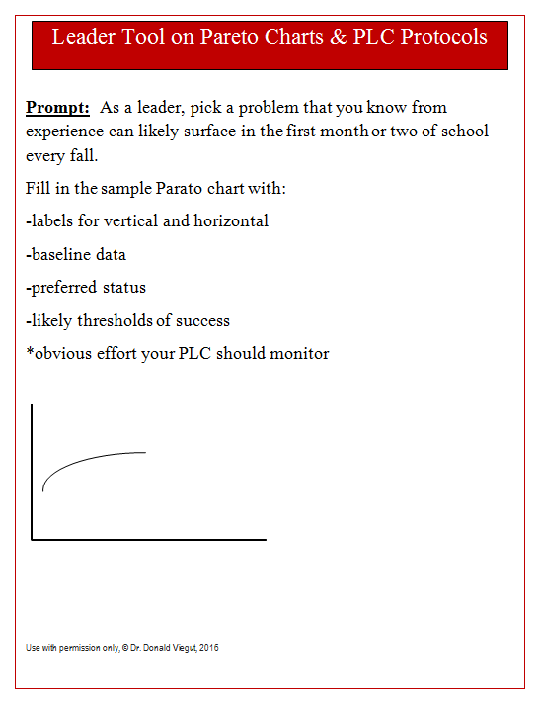
Rely on Pareto Charts and PLC Protocols

Slide 52

Focus on Talent Development

Slide 53
War on Talent
“Ultimately, the war will be global, and for businesses, the stakes will be success and perhaps even survival.”
“The most important corporate resource over the next 20 years will be talent.”
“Over the past decade, talent has become more important than capital, strategy, or R&D.”
“Talented people, in the right kind of culture, have better ideas, execute those ideas better - and even develop other people better.”
http://www.fastcompany.com/34512/war-talent

Slide 54
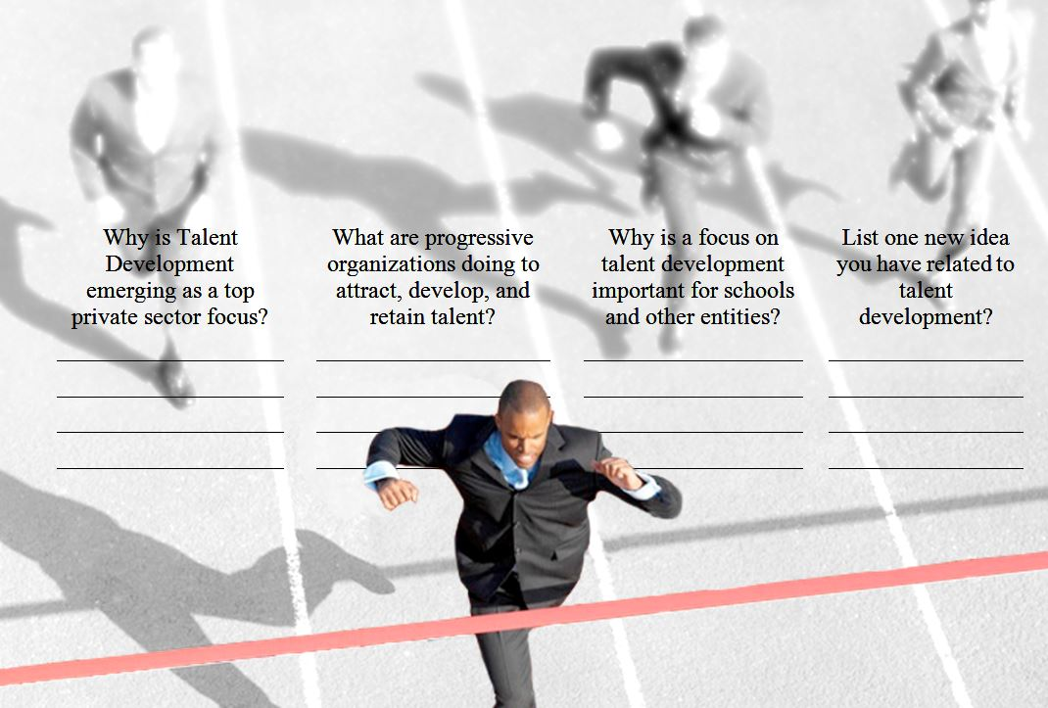
Focus on Talent Development

Slide 55
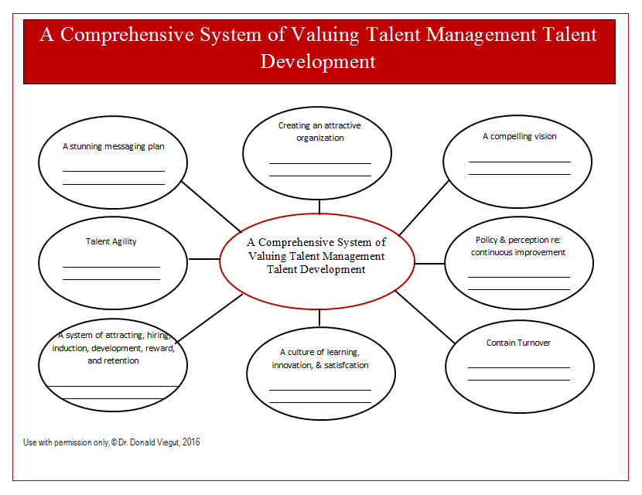
A Systems Approach on Talent Development

Slide 56
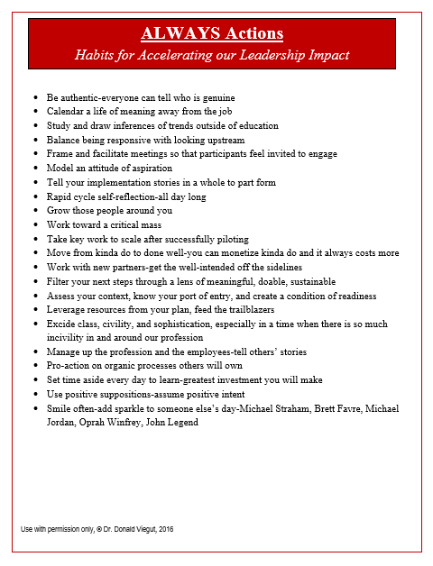
Always Actions

Slide 57
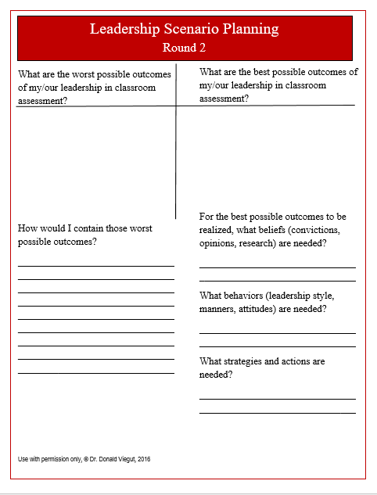
Rely on Leadership Scenario Planning Round 2

Slide 58
Voice of Customer
Today I learned:
_________________________________________________________________________________________________________________________________
Suggestions:
_________________________________________________________________________________________________________________________________

